Slide 1
COMPUTER ALGORTHMS DESIGN & ANALYSIS
CVR COLLEGE OF ENGINEERING
DEPARTMENT OF COMPUTER SCIENCE & ENGINEERING
Academic Year (2021-2022)
R18 REGULATION III BTech(CSE) I SEM, SUB. CODE : 65302
Dr. N. Subhash Chandra,
Professor, CSE.
Text Books:
1. E. Horowitz and S.Sahni, Fundamentals of algorithms, 2nd edition Galgotia Publications, 2010
2. T.H.Cormen, C.E.Leiserson, R.L.Rivest, and C.Stein, Introduction to algorithms, 2nd edition, HI/Pearson Education, 2001

Slide 2
Draw a flow chart of your life and goals. Write an Algorithm of your life.

Slide 3
Course syllabus
COMPUTER ALGORITHMS DESIGN & ANALYSIS Code 65302
Instruction : 3 periods / week Sessional Marks :30Marks
Tutorial : End Examination : 70 Marks
Credits : 3 End Exam Duration : 3 Hours
UNIT I : Fundamentals of algorithm analysis: introduction- Definition of algorithm, algorithmic problem solving, framework for analysis of algorithm- brute force and store and reuse method. Asymptotic notations- O, Ω, and θ notations, properties of asymptotic notations. Recursive algorithms and recurrence relations- ToH problem.
UNIT II : Algorithm paradigms: Divide and Conquer- control abstraction, binary search algorithm and its complexity, max min search, stable and unstable algorithms, quick sort, its complexity, convex hull problem, depth first search(dfs), topological sorting, breadth first search (bfs), articulation points.
UNIT III : Greedy paradigm: control abstraction, fractional knapsack problem, job sequencing problem, minimum spanning tree, Prims algorithm, Disjoint subsets, Kruskal’s algorithm, Huffman code, Dijkstra’s algorithm.
UNIT IV : Dynamic programming: control abstraction, Multistage Graphs, OBST, Matrix chain multiplication, multiplicative optimization, reliability design, 0/1 knapsack problem.
UNIT V: Optimization problems as search problems: Back Tracking, n-queens problem, Graph coloring, Subset-sum modeling Branch and Bound- introduction, Data structure support and TSP. Randomized algorithms, P- problems, tractable algorithms, Definition of different NP problems.

Slide 4
Course Outcomes
CO1: Analyze worst-case running times using asymptotic analysis of algorithms
CO2: Describe the divide-and-conquer paradigm and Synthesize divide-and-conquer algorithms.
CO3: Define optimization problems and solve them through various greedy policies
CO4: Describe the dynamic-programming paradigm and synthesize dynamic programming algorithms, and analyze them.
CO5: Reduce size of search space of the optimization problems by applying backtracking and branch and bound tools. Appreciate the Non-Deterministic modeling of algorithms

Slide 5
UNIT I : Fundamentals of algorithm analysis: introduction- Definition of algorithm, algorithmic problem solving, framework for analysis of algorithm- brute-force and store and reuse method. Asymptotic notations- O, Ω, and θ notations, properties of asymptotic notations. Recursive algorithms and recurrence relations- ToH problem.

Slide 6
Fundamentals of Algorithm Analysis
CONTENTS
Introduction
Definition of algorithm
Algorithmic Problem solving
Methods of Specifying an Algorithm
Steps for writing an algorithm(Pseudo code)
Sample Problems and Algorithms
Quiz
Important Questions

Slide 7
Algorithm Background
Algorithm: The word algorithm came from the name of a Persian mathematician Abu Jafar Mohammed Ibn Musa Al Khowarizmi (ninth century).
An algorithm is simply s set of rules used to perform some calculations either by hand or more usually on a machine (computer).
Definition:
An algorithm is a finite sequence of unambiguous instructions for solving a particular problem. It must satisfy the specific characteristics.

Slide 8
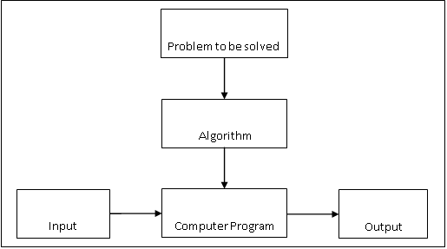
The notion of the algorithm.

Slide 9
The notion of the algorithm illustrates some important points:
It is a step by step procedure with the input to solve the problem in a finite amount of time to obtain the required output.
The notion of the algorithm illustrates some important points:
The non-ambiguity requirement for each step of an algorithm cannot be compromised.
The range of inputs for which an algorithm works has to be specified carefully.
The same algorithm can be represented in several different ways
There may exist several algorithms for solving the same problem.
Algorithms for the same problem can be based on very different ideas and can solve the problem with dramatically different speeds.

Slide 10
Characteristics of an algorithm.
Input : Zero / more quantities are externally supplied.
Output: At least one quantity is produced.
Definiteness: Each instruction is clear and unambiguous.
Finiteness: If the instructions of an algorithm is traced then for all cases the algorithm must terminates after a finite number of steps.
Efficiency: Every instruction must be very basic and runs in short time with effective results better than human computations.

Slide 11
3. Algorithmic Problem solving
Existing Design Techniques
Iterative method
Recursive Method
Brute-force
Divide and Conquer
Greedy Method
Dynamic Programming
Brach and Bound Method
Backtracking Method
Optimization Method
Random Method
Existing Data Structures
Array
Linked List
Stack
Queue
Binary Tree
Binary Search Tree
Heap Tree
Red Black Tree
Quad Tree
Un-directed Graph
Directed Graph
Planar Graph
Real World Problem
Understand the Problem
Selected the appropriate Design Techniques and Data Structures
Write the Computational Solutions (Algorithms)
Validate the Algorithms
Analysis the Algorithms
Selected the efficient Algorithm
Implement the algorithm for selected language
Testing Program

Slide 12
Understanding the Problem
This is the first step in designing of algorithm.
Read the problem’s description carefully to understand the problem statement completely.
Ask questions for clarifying the doubts about the problem.
Identify the problem types and use existing algorithm to find solution.
Input (instance) to the problem and range of the input get fixed.

Slide 13
Issues for Algorithm
There are various issues in the study of algorithms;
How to devise algorithms: The creation of an algorithm is a logical activity which may never be fully automated.
How to express algorithms: We shall express all of our algorithms using the best principles of structuring.
How to validate algorithms: After creation of algorithms is to validate algorithms. The process of checking an algorithm computes the correct answer for all possible legal inputs is called algorithm validation. The purpose of validation of algorithm is to find whether algorithm works properly without being dependent upon programming languages.
How to analyze algorithms: Analysis of algorithm is a task of determining how much computing time and storage is required by an algorithm. Analysis of algorithms is also called performance analysis. The behavior of algorithm in best case, worst case and average case needs to be obtained.
How to test a program: Testing a program really consists of two phases:
Debugging: While debugging a program, it is checked whether program produces faulty results for valid set of input and if it is found then the program has to be corrected.
Profiling or performance measuring: Profiling is a process of measuring time and space required by a corrected program for valid set of inputs.

Slide 14
How to devise algorithms?
Creating an algorithm is an art which may never be fully automated. In this research we want to study more design techniques and select appropriate design techniques to devise the new useful algorithm. The most important design techniques are
Brute-force or exhaustive search
Divide and Conquer
Greedy Algorithms
Dynamic Programming
Branch and Bound Algorithm
Randomized Algorithm
Backtracking

Slide 15
How to validate algorithms?
Once an algorithm is devised, it is necessary to show that it computes the correct answer for all possible legal inputs.
It helps to the next process for writing program code in a particular programming language.
This phase is also called program proving or program verification.
The proof of correctness requires that the solution be stated in two forms.
First form, In this form a program which is annotated by a set of assertations about the input and output variables of the program. Then these assertations are often expresses in the predicate calculus.
Second form is called specification, and this expressed in the predicate calculus.

Slide 16
How to analysis algorithms?
Efficiency of an algorithm can be analyzed at two different stages, before and after implementation.
Before implementation(priori analysis), analysis of algorithms refers to the task of determining how much computing time and storage space an algorithm require.
This is the challenging area which require great mathematical skill.(Quantitative judgement about the algorithms)
An algorithm perform in the best case, the worst case or on the average case are typical.

Slide 17
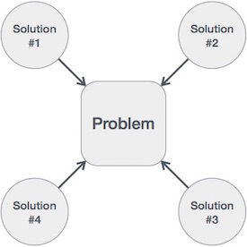
Algorithm Solutions for a Given problem

Slide 18
How to test a program?
After implementation(posterior analysis), Testing a program consists of two phases:
Debugging
Profiling
Debugging is the process of executing programs on sample data sets to determine whether the faulty results occur if so to correct them.
Profiling or performance measurement is the process of executing a correct program on data sets and measuring time and space it takes to compute the results.

Slide 19
Methods of Expressing Algorithm

Slide 20
Natural Language
It is very simple and easy to specify an algorithm using natural language. But many times, specification of algorithm by using natural language is not clear and thereby we get brief specification.
Example: An algorithm to perform addition of two numbers.
Step 1: Read the first number, say a.
Step 2: Read the first number, say b.
Step 3: Add the above two numbers and store the result in c.
Step 4: Display the result from c.
Such a specification creates difficulty while implementing it. Hence many programmers prefer specification of algorithm by means of Pseudocode.

Slide 21
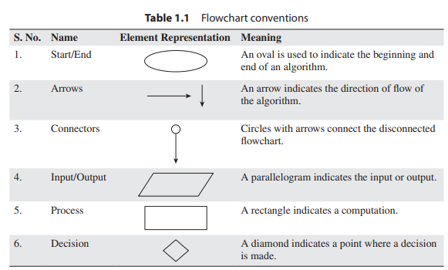
Flowchart

Slide 22
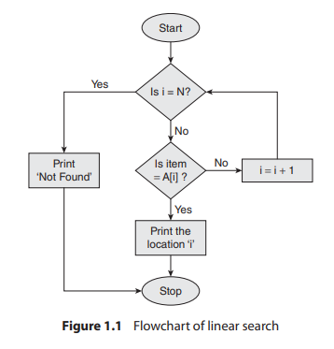
Flowchart : Example

Slide 23
Pseudocode
Pseudocode is a mixture of a natural language and programming language constructs. Pseudocode is usually more precise than natural language.
For Assignment operation left arrow “:=”, for comments two slashes “//”,if condition, for, while loops are used.
ALGORITHM Sum(a, b)
{
//Problem Description: This algorithm performs addition of two numbers
//Input: Two integers a and b
//Output: Addition of two integers
c:=a+b;
return c;
}
This specification is more useful for implementation of any language.

Slide 24
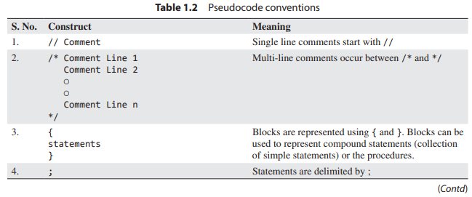
Pseudocode conventions

Slide 25
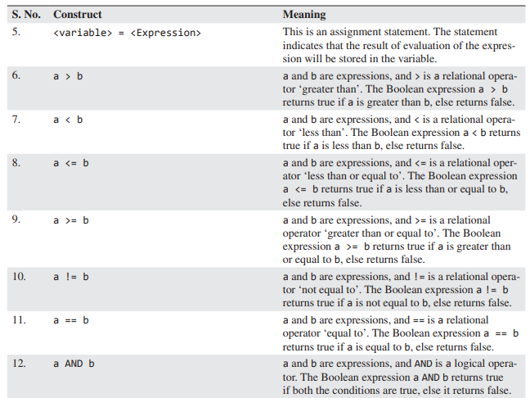
Pseudocode conventions

Slide 26
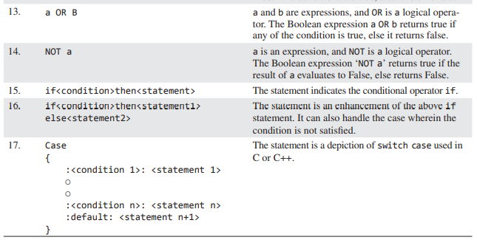
Pseudocode conventions

Slide 27
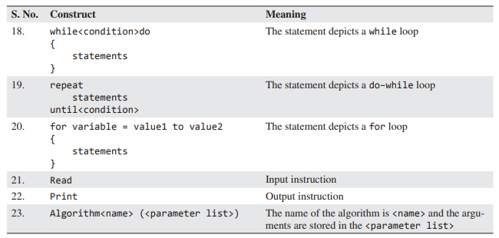
Pseudocode conventions

Slide 28
Steps for writing an algorithm(Pseudo code):
An algorithm is a procedure. It has two parts; the first part is head and the second part is body.
The Head section consists of keyword Algorithm and Name of the algorithm with parameter list.
E.g. Algorithm name1(p1, p2,…,pn)
The head section also has the following:
//Problem Description:
//Input:
//Output:
In the body of an algorithm various programming constructs like if, for, while and some statements like assignments are used.
The compound statements may be enclosed with { and } brackets. if, for, while can be open and closed by {, } respectively. Proper indention is must for block.
Comments are written using // at the beginning.

Slide 29
The identifier should begin by a letter and not by digit. It contains alpha numeric letters after first letter. No need to mention data types.
The left arrow “:=” used as assignment operator. E.g. v:=10
Boolean operators (TRUE, FALSE), Logical operators (AND, OR, NOT) and Relational operators (<,<=, >, >=,=, ≠, <>) are also used.
Input and Output can be done using read and write.
Array[], if then else condition, branch and loop can be also used in algorithm.

Slide 30
Operators and Conditional Statement(Pseudo code):
There are two Boolean values TRUE and FALSE. Logical operators: AND, OR, NOT.
Relational operators: <, >, ≥,≤,=,≠. Arithmetic operators: +, -, *, /, %;
The conditional statement if-then or if-then-else is written in the following form. If (condition) then (statement)
If (condition) then {Block-1 }else { Block-2}
‘If’ is a powerful statement used to make decisions based as a condition. If a condition is true the particular block of statements are execute.
Example
if(a>b) then
{
write("a is big");
}
else
{
write("b is big");
}

Slide 31
Case Statement(Pseudo code):
Case statement
case
{
:(condition -1): (statement-1)
:(condition -2): (statement-2)
:(condition -n): (statement-n)
..............
..............
else :(statement n+1);
}
If condition -1 is true, statement -1 executed and the case statement is exited. If statement -1 is false, condition -2 is evaluated. If condition -2 is true, statement-2 executed and so on. If none of the conditions are true, statement –(n+1) is executed and the case statement is exited. The else clause is optional.

Slide 32
for loop statement(Pseudo code):
Loop statements: For loop:
The general form of the for loop is
for variable:=value1 to value2 step value3 do
{
Statement -1;
Statement -2;
...
...
Statement -n;
}
Example 1:
for i:=1 to 10 do
{
write(i); //displaying numbers from 1 to 10 i:=i+1;
}
Example 2:
for i:=1 to 10 step 2 do
{
write(i); //displaying numbers from 1 to 10 i:=i+2;
}

Slide 33
While Statement(Pseudo code):
while loop:
The general form of whileis-
while (condition) do
{
statement 1;
statement 2;
...
...
statement n;
}
Example
i:=1;
while(i<=n) do
{
write (i); i:=i+1;
}

Slide 34
repeat-until statement(Pseudo code):
Repeat-until loop:
The general form of repeat-until is-
repeat
{
statement 1;
statement 2;
...
...
statement n;
}until (condition);
Example
i:=1;
repeat
{
write (i); i:=i+1;
}
until (i>10);

Slide 35
Break, Array and function Statement(Pseudo code):
Break: this statement is exit from the loop.
Elements of array are accessed using [ ].
For example, if A is an one-dimensional array, then i^{th} element can be accessed using A[i].
If A is two-dimensional array, then (i, j)^{th} element can be accessed using A[i,j].
Procedures (functions): There is only one type of procedure:
An algorithm consists of a heading and a body.

Slide 36
SAMPLE ALGORITHMS

Slide 37
Write an algorithm to find maximum element in an array with size ‘n’.
Algorithm Max(A, n)
// This algorithm return the maximum element in the given array A with size n
{
maximum=A[1];
for i=2 to n do
if A[i]>maximum then
maximum=A[i];
return maximum;
}

Slide 38
VERIFICATION

Slide 39
Write a linear sort algorithm to sort the data in an array with size ‘n’.
Ans:
Algorithm LinearSort(A, n)
// This algorithm return the sorted(ascending order) array for the given array A with size n
{
for i=1 to n-1 do{
for j=i+1 to n do
if A[i]>A[j] then
{
temp=A[i];
A[i]=A[j];
A[j]=temp;
}
}
return A;
}

Slide 40
VALIDATE THE ALGORITHM
 | VERIFY THE ALGORITHM
 |  | PASS 1: Fix the first minimum element in the first position
INDEX | A | I=1, J=2 | I=1,J=3 | I=1,J=4 | I=1,J=5
1 | 23 | 12 | 12 | 7 | 7
2 | 12 | 23 | 23 | 23 | 23
3 | 18 | 18 | 18 | 18 | 18
4 | 7 | 7 | 7 | 12 | 12
5 | 20 | 20 | 20 | 20 | 20
 | RULE 1 : IF A[I]>A[J] THEN INTERCHANGE(A[I], A[J]) ELSE NO-ACTION

Slide 41
3. Write an algorithm for finding max and min in an array of n elements.
Algorithm MaxMin(A, n)
// This algorithm return the max and min values in a given array A, n- size of the array.
{
maximum:=A[1];
minimum:=A[1];
for i:=2 to n do
{
if A[i]<maximum then maximum:=A[i];
if A[i]>minimum then minimum:=A[i];
}
return([minimum, maximum]);
}

Slide 42
4. Write an algorithm for Bubble Sort an array of n elements.
Algorithm BubbleSort(A, n)
// This algorithm return the sorted(ascending order) array for the given array A with size n
{
for i=1 to n-1 do{
for j=1 to n-i do
if A[j]>A[j+1] then {
temp=A[j];
A[j]=A[j+1];
A[j+1]=temp;
}
}

Slide 43
 | BUBBLE SORT
 | VERIFY THE ALGORITHM
 |  | PASS 1: Fix the largest element at last position
INDEX | KEY-A | I=1 | I=2 | I=3 | I=4
1 | 23 | 12 | 12 | 12 | 12
2 | 12 | 23 | 18 | 18 | 18
3 | 18 | 18 | 23 | 7 | 7
4 | 7 | 7 | 7 | 23 | 20
5 | 20 | 20 | 20 | 20 | 23
 | RULE 1 : IF A[i]>A[i+1] THEN INTERCHANGE(A[I], A[J]) ELSE NO-ACTION
 |  | PASS 3: Fix the third largest data in its position
INDEX | KEY-A | I=1 | I=2
1 | 12 | 7 | 7
2 | 7 | 12 | 12
3 | 18 | 18 | 18
4 | 20 | 20 | 20
5 | 23 | 23 | 23
 | RULE 1 : IF A[i]>A[i+1] THEN INTERCHANGE(A[I], A[J]) ELSE NO-ACTION
 |  | PASS 2: Fix the second largest data in its position
INDEX | KEY-A | I=1 | I=2 | I=3
1 | 12 | 12 | 12 | 12
2 | 18 | 18 | 7 | 7
3 | 7 | 7 | 18 | 18
4 | 20 | 20 | 20 | 20
5 | 23 | 23 | 23 | 23
 | RULE 1 : IF A[i]>A[i+1] THEN INTERCHANGE(A[I], A[J]) ELSE NO-ACTION
 |  | PASS 4: Fix the fourth largest data in its position
INDEX | KEY-A | I=1
1 | 7 | 7
2 | 12 | 12
3 | 18 | 18
4 | 20 | 20
5 | 23 | 23
 | RULE 1 : IF A[i]>A[i+1] THEN INTERCHANGE(A[I], A[J]) ELSE NO-ACTION

Slide 44
5. Write an algorithm for Selection Sort an array of n elements.
Algorithm SelectionSort(A, n)
// This algorithm return the sorted(ascending order) array for the given array A with size n
{
for i:=1 to n-1 do{
pos:=i;
for j:=i+1 to n do{
if A[j]<A[pos] then pos:=j;
}
temp=A[pos]
A[pos]:=A[i];
A[i]:=temp
}
return(A);
}

Slide 45
 | SELECTION SORT
 | VERIFY THE ALGORITHM
PASS 1: Fix the first min data in its positon
INDEX | KEY-A | I=1,pos=2 | I=1,pos=2 | I=1,pos=4 | I=1, pos=4
1 | 23 | 23 | 23 | 23 | 7
2 | 12 | 12 | 12 | 12 | 12
3 | 18 | 18 | 18 | 18 | 18
4 | 7 | 7 | 7 | 7 | 23
5 | 20 | 20 | 20 | 20 | 20
 | RULE 1 : Find the minimum element position and interchange A[i] and A[pos]
PASS 2: Fix the second minimum data in its positon
INDEX | KEY-A | I=2, pos=2 | I=2,pos=2 | I=2, pos=2
1 | 7 | 7 | 7 | 7
2 | 12 | 12 | 12 | 12
3 | 18 | 18 | 18 | 18
4 | 23 | 23 | 23 | 23
5 | 20 | 20 | 20 | 20
PASS 3: Fix the third minimum data in its positon
INDEX | KEY-A | I=3,pos=3 | i=3, pos=3
1 | 7 | 7 | 7
2 | 12 | 12 | 12
3 | 18 | 18 | 18
4 | 23 | 23 | 23
5 | 20 | 20 | 20
PASS 4: Fix the fourth minimum data in its positon
INDEX | KEY-A | I=4, pos=5
1 | 7 | 7
2 | 12 | 12
3 | 18 | 18
4 | 23 | 20
5 | 20 | 23

Slide 46
6. Write an algorithm for Insertion Sort an array of n elements.
Algorithm Insertion Sort(A, n)
// This algorithm return the sorted(ascending order) array for the given array A with size n
{
for i:=2 to n do{
insertdata :=A[i];
j:=i-1;
while (j > 0 AND A[j] > insertdata){
A[j+1]=A[j];
j:=j-1;
}
A[j+1]:=insertdata;
}
return(A);
}

Slide 47
Performance Analysis:
Performance analysis or analysis of algorithms refers to the task of determining the efficiency of an algorithm
To judge an algorithm, particularly two things are taken into consideration
Space complexity
Time complexity

Slide 48
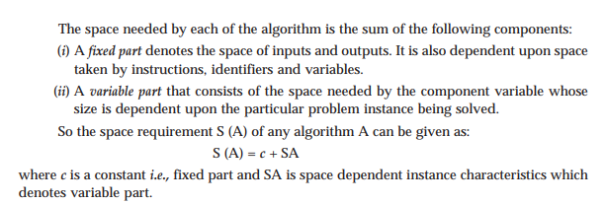
Space Complexity
The fixed part includes space for
Instructions
Simple variables
Fixed size component variables
Space for constants, Etc..
The variable part includes space for
Component variables whose size is dependent on the particular problem instance being solved
Recursion stack space, Etc..

Slide 49
Space Complexity: Examples
Algorithm NEC (float x, float y, float z)
{
Return (X + Y +Y * Z + (X + Y +Z)) /(X+ Y) + 4.0;
}
In the above algorithm, there are no instance characteristics and the space needed by X, Y, Z is independent of instance characteristics, therefore we can write, S(XYZ) =3+0=3 One space each for X, Y and Z Space complexity is O(1).
Algorithm ADD ( float [], int n)
{
sum := 0.0; for i:=1 to n do
sum:=sum + X[i]; return sum;
}
Here, atleast n words since X must be large enough to hold the n elements to be summed. Here the problem instances is characterized by n, the number of elements to be summed. So, we can write, S(ADD) =3+n 3-one each for n, I and sum Where n- is for array X[], Space complexity is O(n).

Slide 50
Time Complexity
The time complexity of a problem is
The number of steps that it takes to solve an instance of the problem as a function of the size of the input (usually measured in bits), using the most efficient algorithm.
Priori analysis
Posteriori analysis or run (execution) time.
Time complexity T(P) = C + TP(n)
In general it can be two measured in ways:
By Bruit force method Time= Compile Time +Run Time
 Example:
T_{P}(n) = CaADD(n)+ CsSUB(n)+ CmMUL(n)+ CdDIV(n)+……………..
By using step count method.

Slide 51
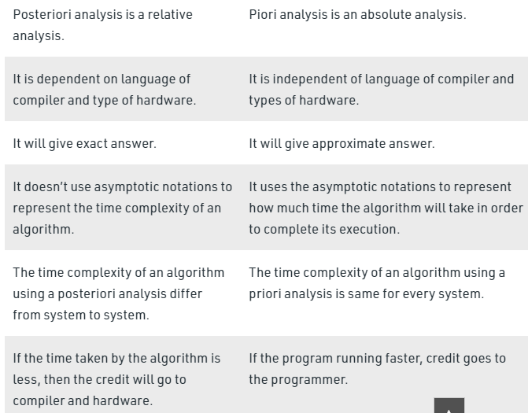
Difference Between Priori and Posteriori Analysis

Slide 52
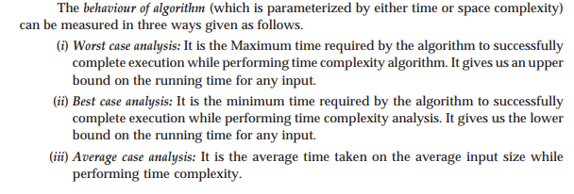
Behaviour of An Algorithm
Example:
Best Case: Inputs are provided in such a way that the minimum time is required to process them. O(1)
Average Case: The amount of time the algorithm takes on an average set of inputs. O(n/2)
Worst Case: The amount of time the algorithm takes on the worst possible set of inputs . O(n)
Example: Linear Search

Slide 53
Time Complexity: Examples
Statement | S/e | Frequency | Total steps
1. Algorithm Sum(a, n) | 0 | - | 0
2. { | 0 | - | 0
3. s:=0; | 1 | 1 | 1
4. for i:=1 to n do | 1 | n+1 | n+1
5. s:=s+a[i]; | 1 | n | n
6. return s; | 1 | 1 | 1
7. } | 0 | - | 0
Total |  |  | 2n+3 steps
Ex:

Slide 54
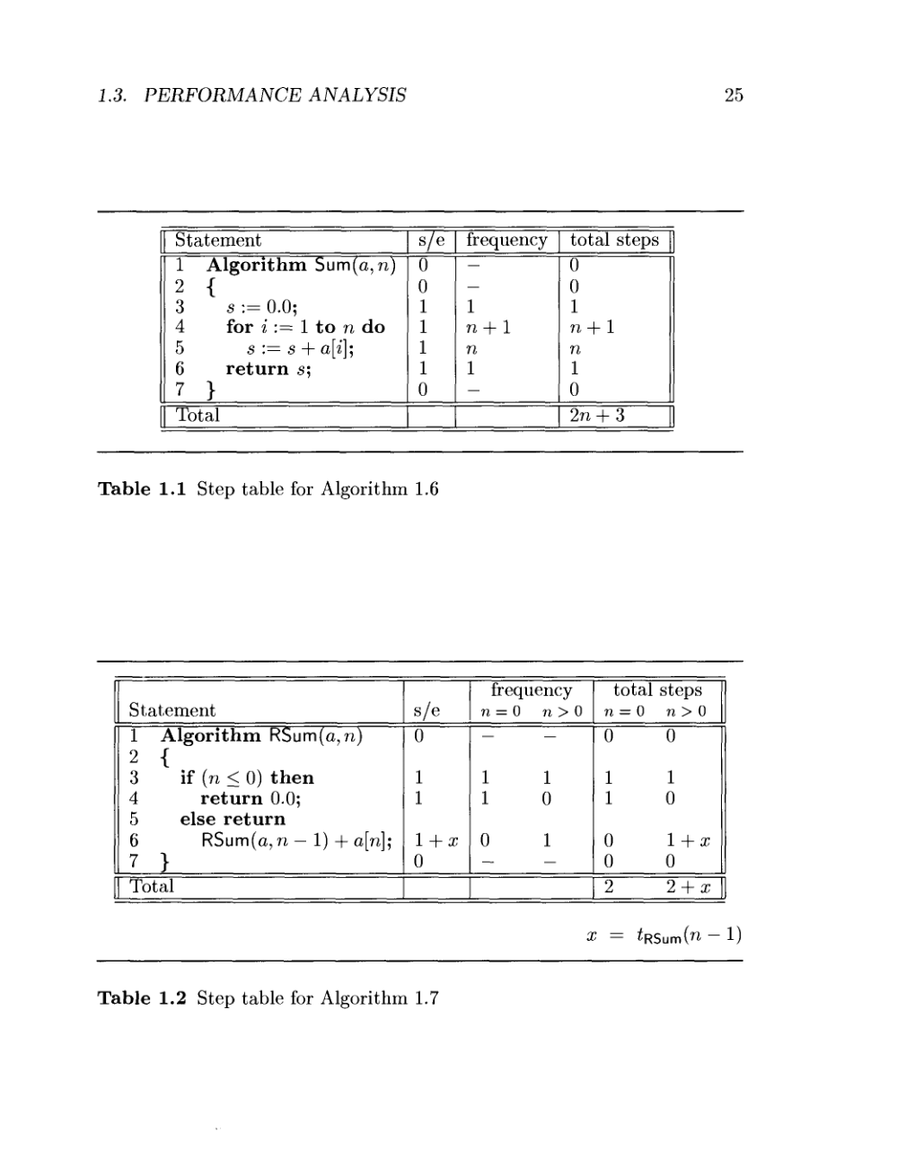

Slide 55
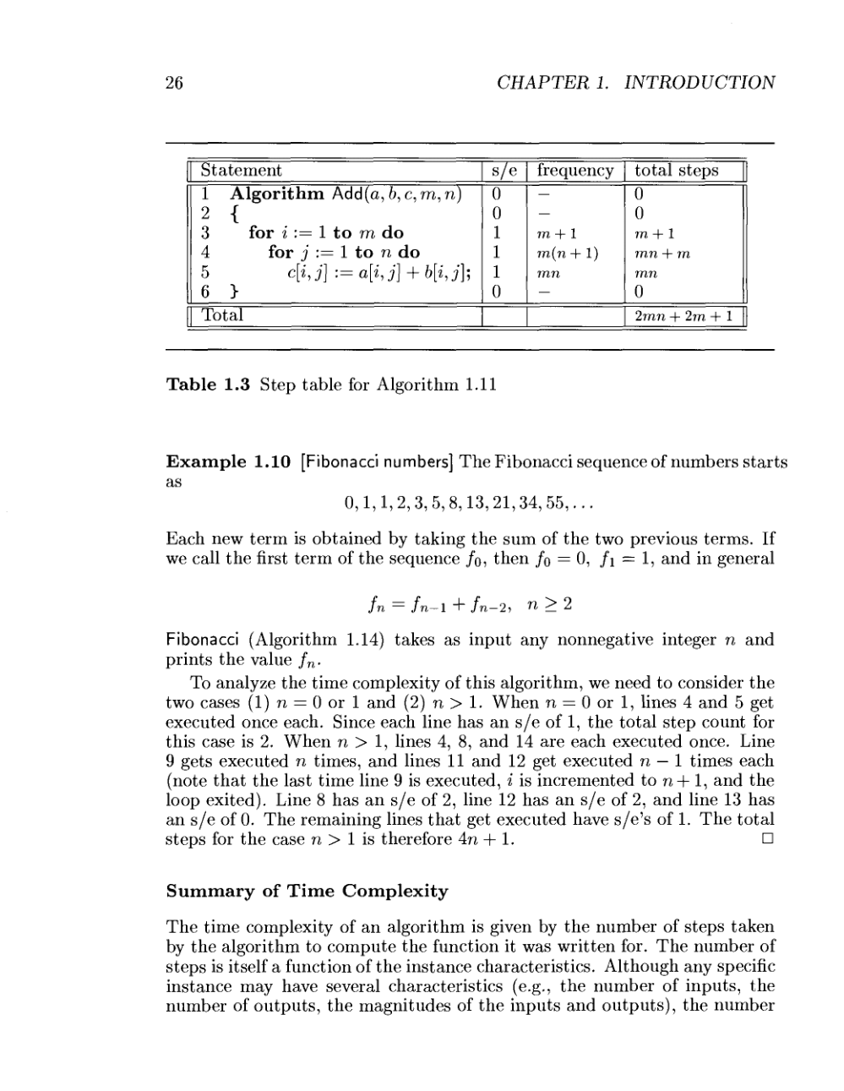
Time complexity of Matrix addition

Slide 56
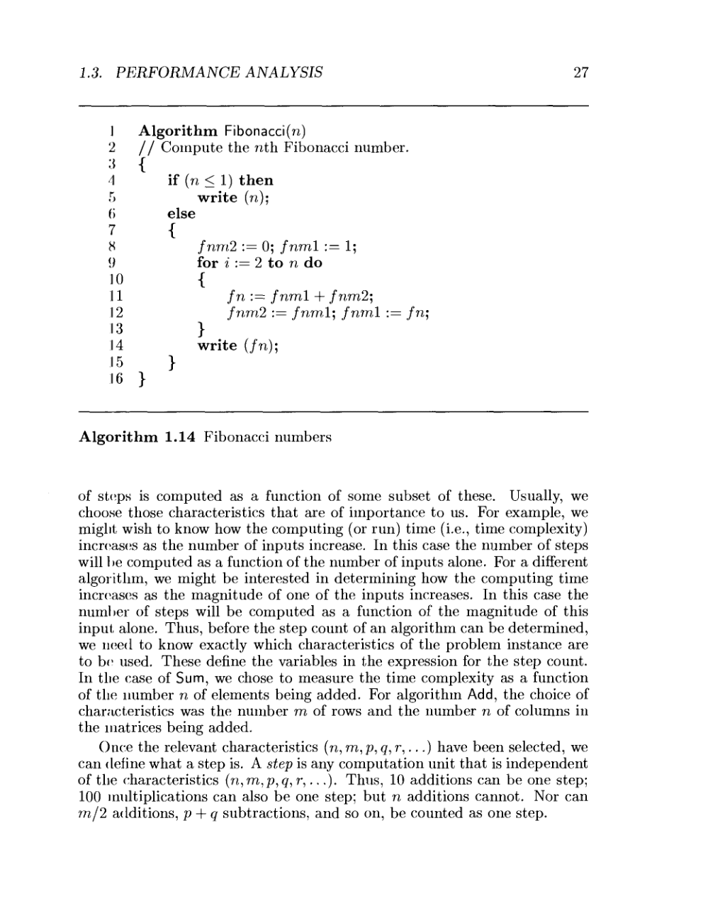
Time complexity of Fibonacci number

Slide 57
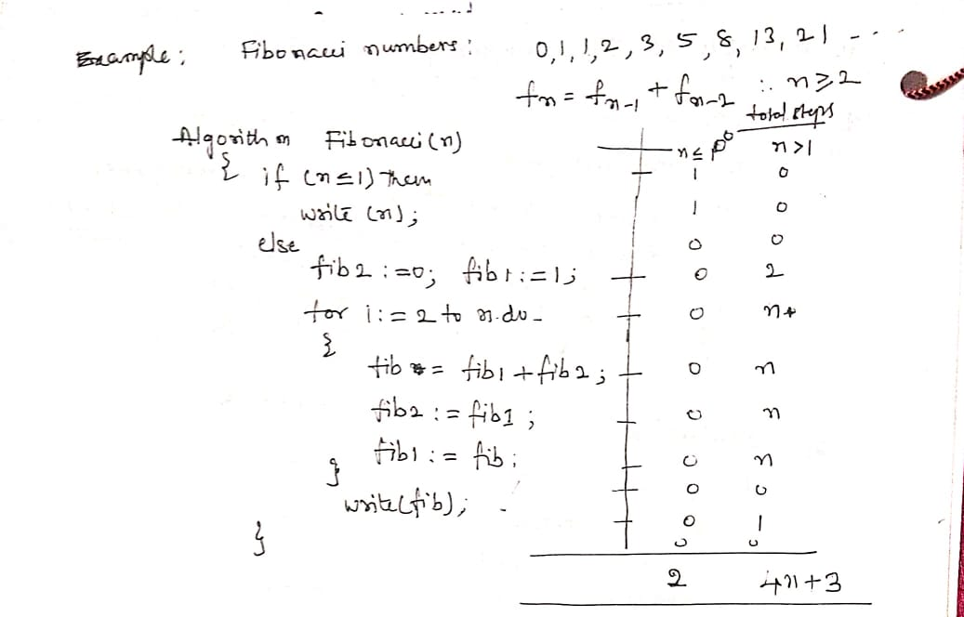

Slide 58
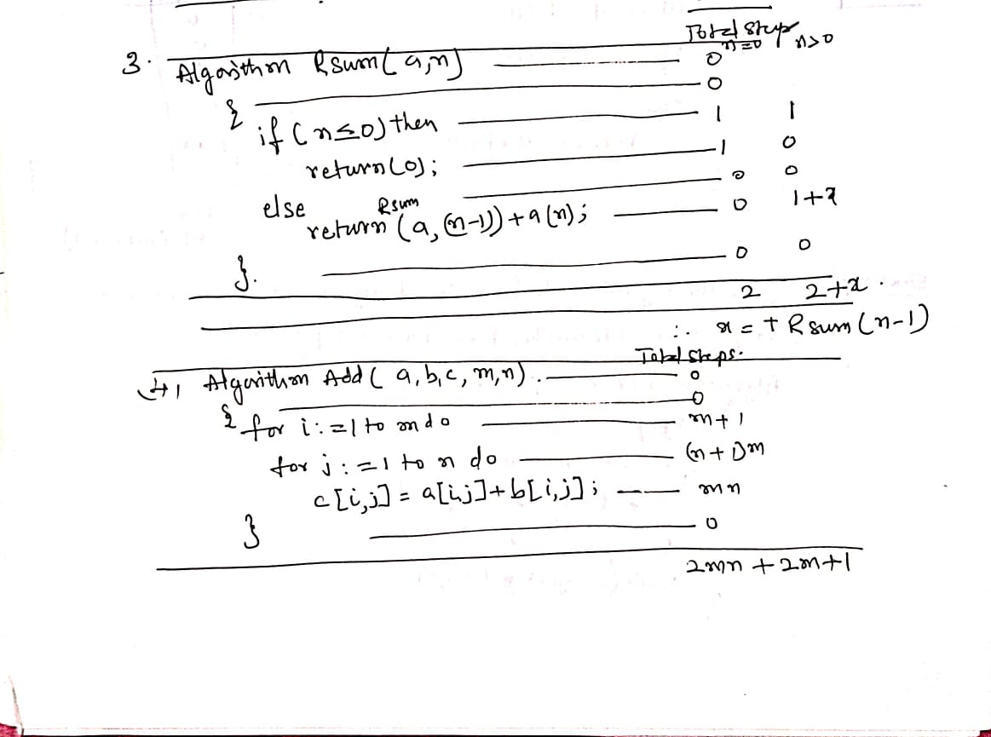

Slide 59
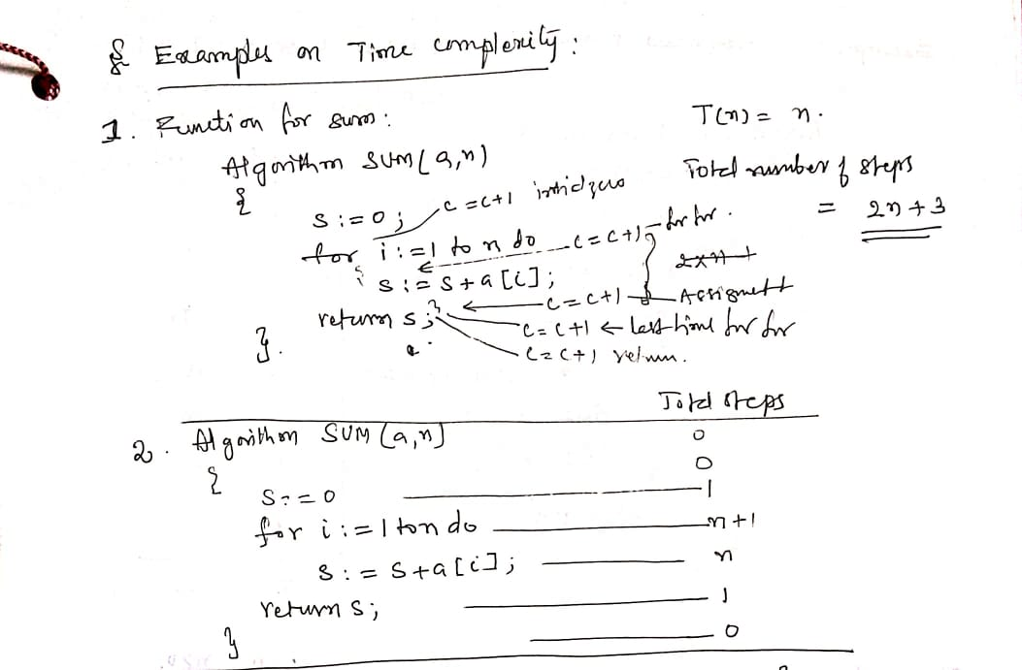

Slide 60
Important questions
Define algorithm
What is pseudo code?
How to device an algorithm?
How to validate an algorithm?
How to analysis an algorithm?
How to test a program?
What are the characteristics of an algorithm?
Write an algorithm for linear sort.
Write an algorithm for binary search
Write an algorithm for selection sort.
Write an algorithm for finding max and min in an array of n elements.
Write an algorithm to check the give positive integer is prime or not.
Write an Euclidean algorithm for finding GCD.

